Slide 1

English Language & Linguistics Level 1B
Exam Briefing
18 March 2021

Slide 2

Date & time TBA
Open for 24 hours
Choose two of six essay questions
1 Phonetics
1 Varieties
1 Older Scots
1 Modern Scots
1 Middle English
1 Early-Modern to Present-Day English
You may write on the same topic as your essay, as long as you don’t use ‘substantially the same material’
Expected duration is 1 hour, but if you take longer we won’t know!

Slide 3

How to prepare
Look at generic feedback from 1A exam
Look at sample papers from previous years’ 1B exams through the library
Review Quizzes
Review Seminar materials
Review Lectures
Really, really! Watch every lecture you missed!
Follow up on interesting tidbits by doing external reading from library reading list!

Slide 4
Five tips for success, based on common statements from generic feedback

Slide 5
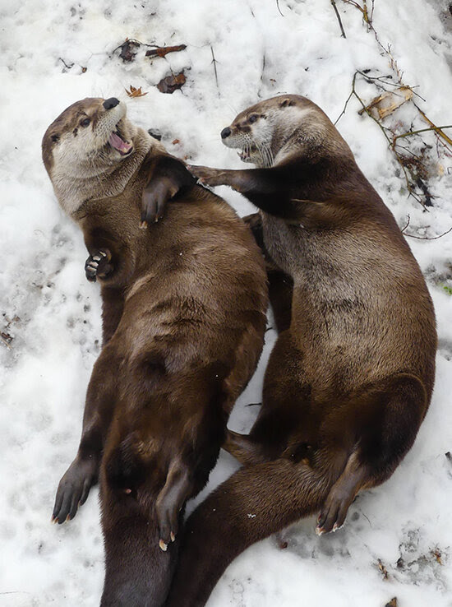
1. Read and answer the question
“Some answers to 2a addressed only one part of the question . . . Since the question asked ‘How and why’, high grades were only achieved by essays that covered both aspects.”
“Less successful answers did not answer all parts of the question fully.”
“Less successful answers did not provide enough detail to answer the question fully.”
“A surprising number included discussion of [X], irrelevant to the question.”

Slide 6
1. Read and answer the question
“Some answers to 2a addressed only one part of the question . . . Since the question asked ‘How and why’, high grades were only achieved by essays that covered both aspects.”
“Less successful answers did not answer all parts of the question fully.”
“Less successful answers did not provide enough detail to answer the question fully.”
“A surprising number included discussion of [X], irrelevant to the question.”

Slide 7

2. Evidence of outside reading & thinking
“Stronger essays . . . showed clear evidence of engagement with recommended reading and beyond.”
“Stronger answers . . . [showed] evidence of reading and examples beyond those presented in the lecture. A few answers even showed independence by discussing [things] which had not been discussed in the lecture.”
“Some of the best essays also drew on background reading, while for 2b, a number of students were able to cite . . . examples from their own experience”
“The best answers . . .were well-illustrated with linguistic examples over and above those given in the lecture.”
“Weaker essays were short and tended to stick closely to an outline of the points recommended for revision, leading to a fair overall performance by the class.”
“Again, weaker answers were short and relied on personal observations.”

Slide 8
2. Evidence of outside reading & thinking
“Stronger essays . . . showed clear evidence of engagement with recommended reading and beyond.”
“Stronger answers . . . [showed] evidence of reading and examples beyond those presented in the lecture. A few answers even showed independence by discussing [things] which had not been discussed in the lecture.”
“Some of the best essays also drew on background reading, while for 2b, a number of students were able to cite . . . examples from their own experience”
“The best answers . . .were well-illustrated with linguistic examples over and above those given in the lecture.”
“Weaker essays were short and tended to stick closely to an outline of the points recommended for revision, leading to a fair overall performance by the class.”
“Again, weaker answers were short and relied on personal observations.”

Slide 9

3. Details and examples
“Those providing linguistic examples also gained higher grades.”
“The strongest essays offered a discussion of counter-examples, and of cross-linguistic correspondences, in order to arrive at a considered conclusion.”
“The best answers focused on textual details and produced discussion anchored around specific points from the passage.”
“The strongest answers illustrated their understanding through the use of original linguistic examples.”
“The best answers clearly and accurately argued the above points, had plenty of relevant detail, were well-illustrated with linguistic examples over and above those given in the lecture, and were well-presented.”
The best answers to question 5b again covered all of [X] and provided appropriate examples of features from each. Some less successful answers focussed too narrowly on one or two [X] only, or provided examples which were not appropriate or not specific to the [X] in question.

Slide 10
3. Details and examples
“Those providing linguistic examples also gained higher grades.”
“The strongest essays offered a discussion of counter-examples, and of cross-linguistic correspondences, in order to arrive at a considered conclusion.”
“The best answers focused on textual details and produced discussion anchored around specific points from the passage.”
“The strongest answers illustrated their understanding through the use of original linguistic examples.”
“The best answers clearly and accurately argued the above points, had plenty of relevant detail, were well-illustrated with linguistic examples over and above those given in the lecture, and were well-presented.”
The best answers to question 5b again covered all of [X] and provided appropriate examples of features from each. Some less successful answers focussed too narrowly on one or two [X] only, or provided examples which were not appropriate or not specific to the [X] in question.

Slide 11

4. Accuracy and understanding
“While the majority of answers defined [X] accurately, many of the weaker answers displayed a poor grasp of supporting detail, with inaccurate recall of [Z], [W], and [Q].
“Less successful answers were characterised by an incorrect definition of one or more of the [X], by a lack of illustrative examples, or by a misunderstanding of [X].”
“There were some strong answers to both, alongside others that were flawed by misconceptions or lack of focus on the question”

Slide 12
4. Accuracy and understanding
“While the majority of answers defined [X] accurately, many of the weaker answers displayed a poor grasp of supporting detail, with inaccurate recall of [Z], [W], and [Q].
“Less successful answers were characterised by an incorrect definition of one or more of the [X], by a lack of illustrative examples, or by a misunderstanding of [X].”
“There were some strong answers to both, alongside others that were flawed by misconceptions or lack of focus on the question”

Slide 13

5. Structure
“Stronger essays had a clear structure/argument (introduction, main sections, conclusion) . . .”
“Stronger answers were longer, better structured with clearer signposting for the argument of the essay . . .”
“Some of these essays offered an integrated discussion of reasons and mechanisms, while others set out first one and then the other. Either approach was fine, providing there was a structured argument.”

Slide 14
5. Structure
“Stronger essays had a clear structure/argument (introduction, main sections, conclusion) . . .”
“Stronger answers were longer, better structured with clearer signposting for the argument of the essay . . .”
“Some of these essays offered an integrated discussion of reasons and mechanisms, while others set out first one and then the other. Either approach was fine, providing there was a structured argument.”

Slide 15



Questions?

